Slide 1
Quantum Cinemas A Movie Booking App
CS 422 Mobile Application Development
Illinois Institute of Technology
By Team14:
Suraj Kumar Didwania (A20334147)
Sushma Mahadevan (A20353021)
Karthik Varadarajan (A20325548)
Adithya R (A20378967)

Slide 2
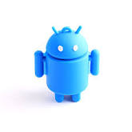
Synopsis:
People usually tend to go out with friends, families or loved ones to watch movies. They demand a genuine and fantastic application to view the movie collection and booking tickets without standing in long queue inside the theatre.
This application is a great community for rating movies, getting ShowTime and Date, watching trailers, getting the movie reviews.
Quantum Cinemas is the destination for those of us looking to discover something different.

Slide 3
Preface:
Hard to book the movie through App? This App is the most consistent app it’s easy to book tickets and get latest movie details and trailers.
Looking for the review of the movie? Just pull this app and find the review.

Slide 4
Purpose:
This application is a great community for watching movie trailers, getting the movie reviews and discussing movie.
Easy, Effective and communicative way to book the movie
Preferable Seat Selection
User friendly navigation
Reliable Movie Booking
Remind users about movie schedule.

Slide 5
Traits:
1) Message Notification
2) Movie Listing/Search
3) Multiplex GUI Seat Selection
4) Movie Reviews and Coming Soon
5) Payment processing
6) Confirmation Email
7) Reminder
8) Confirmation SMS
9) Calculate Theatre Distance
10) Google Sign in
11) Watch Movie Trailer videos

Slide 6

TeamWork
Karthik Vardarajan
Welcome Screen Tabbed Activity and Movie Time/date Theatre Selection, and Share Button
Navigation Menu Bar, Movie listing and Search
Front end development of screens
Adithya R
Multiplex GUI seat selection: SQLite Database Query part to get seats and display seats available, booked seats, select unselect seat
Writing Review like a chat application
Worked on queries to store reviews in firebase
Front end development of screens

Slide 7
TeamWork
Suraj
Payment Processing screen and SQLite database query for storing booked movies Movie
confirmation sending notification
Text to Speech Notification
Theatre Distance from phone location
Payment Processing Screen
Gmail Login
Sushma
Movie Confirmation Screen, SQLite Query to fetch data from db for a booking id displaying movie confirmation details and sending SMS, email confirmation
Java Email API to send email
SMS Manager to send SMS
Reminder to add movie reminder
Coming Soon with Animation
View video using YouTube Video API

Slide 8
Android Technology/Design Pattern
Fragments for Tabbed Activity
Navigation bar with menus
Email API
Notification Manager
SMS Manager
Gmail Login API
Reminder Calendar API
Animation
GPS Location Manager Services
Custom List View and Spinner
SQLite Data Storage
Firebase Data Storage
Linkify
Share Button
YouTube View
Async Task

Slide 9
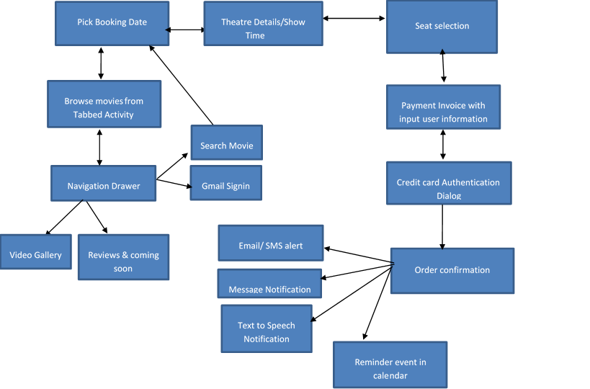
Flow Chart:

Slide 10
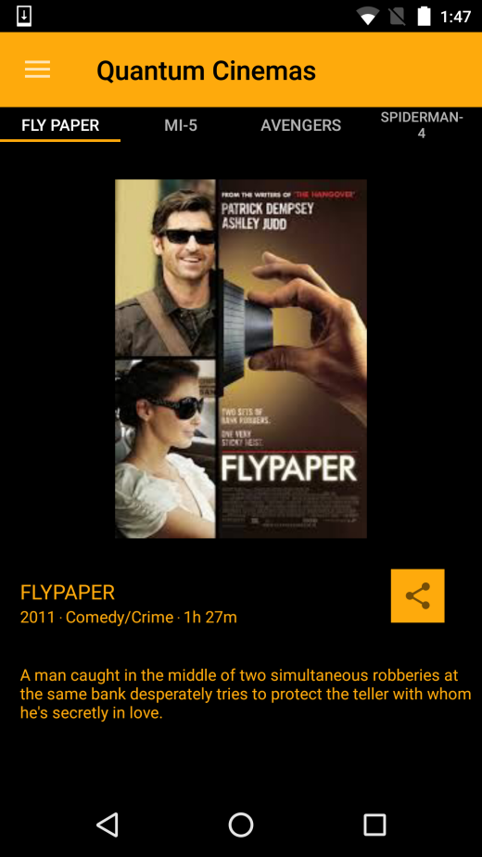
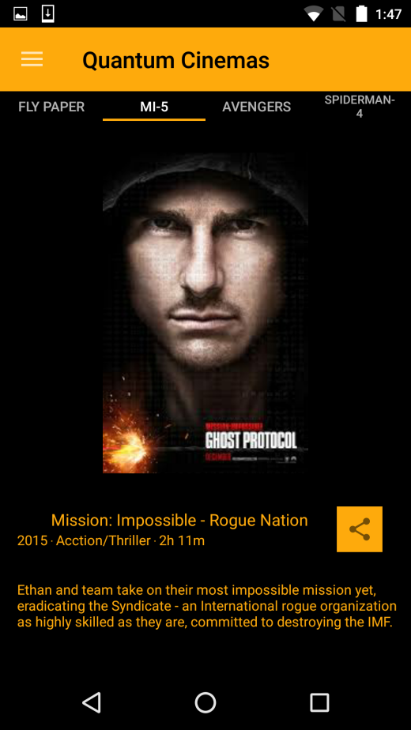
Fragments for Tabbed Activity:

Slide 11
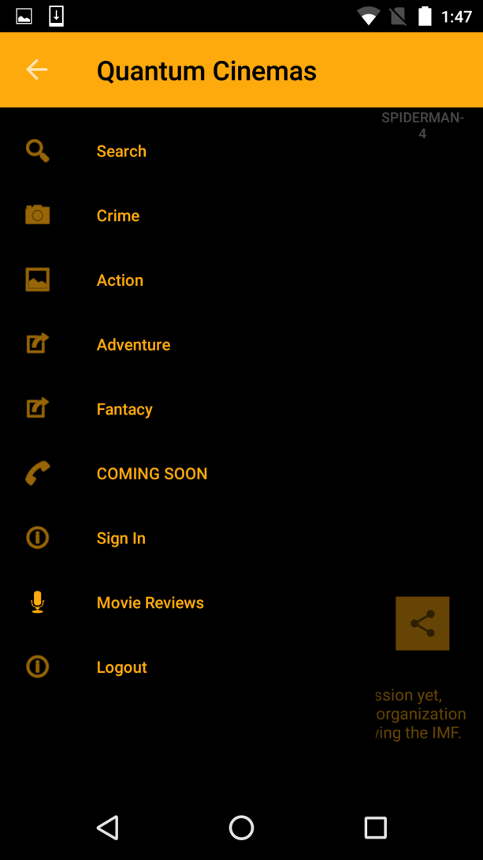
Navigation bar with Menus:

Slide 12
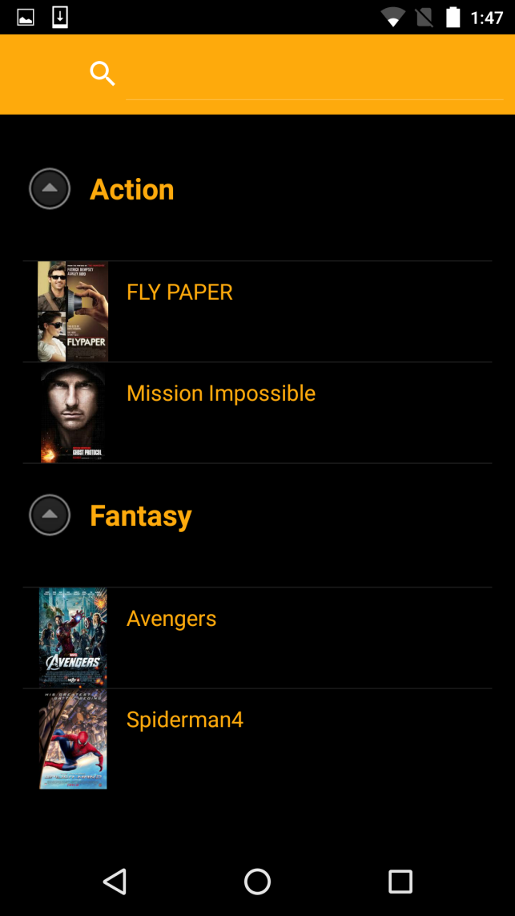
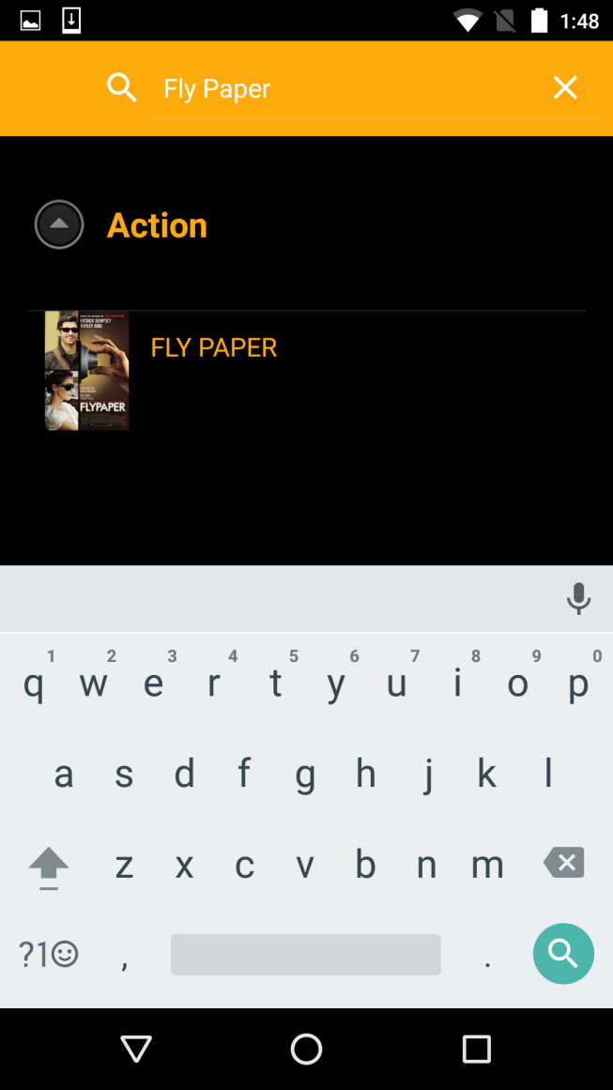
Movie Listing/Search

Slide 13
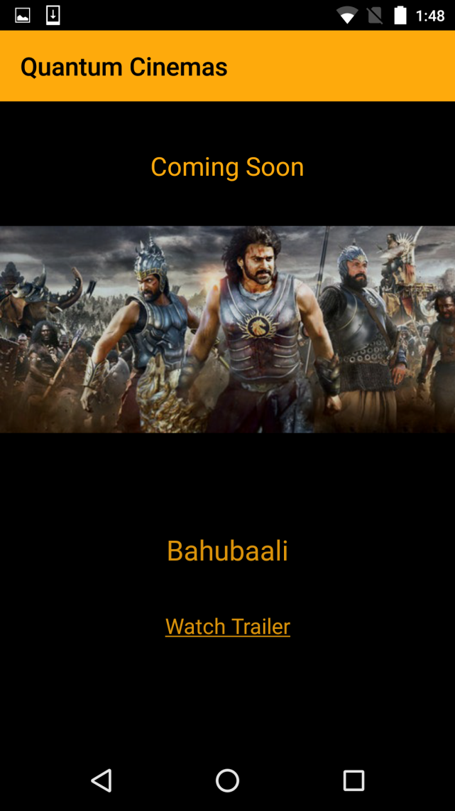
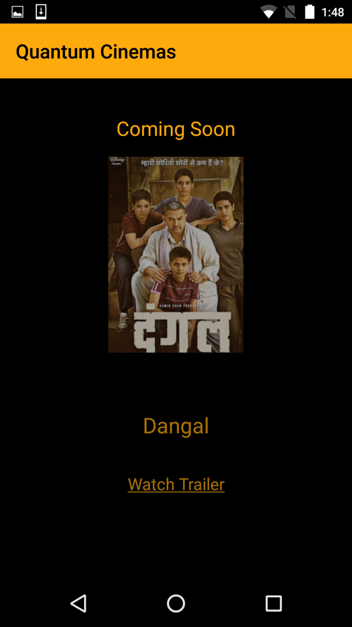
Coming Soon Movies:

Slide 14
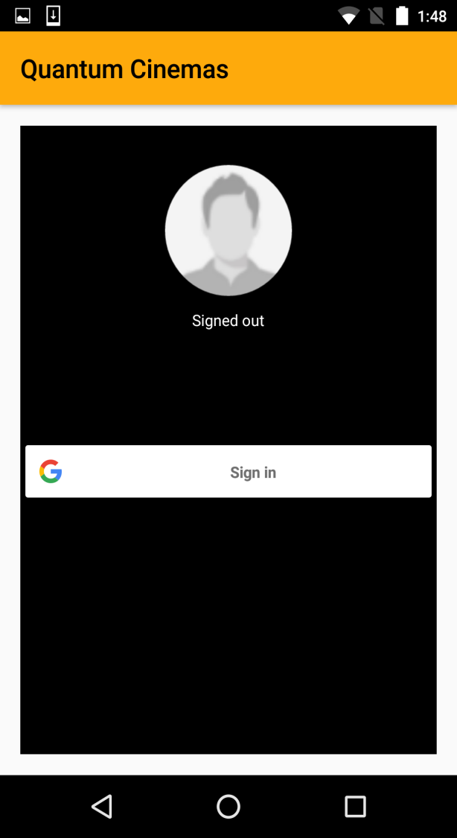
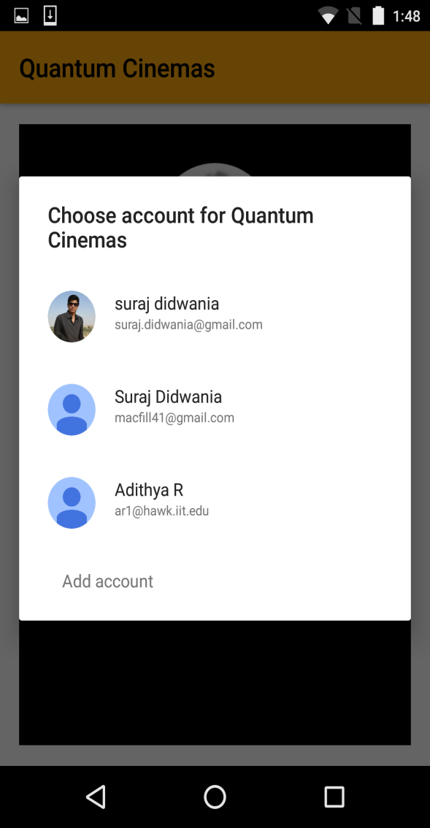
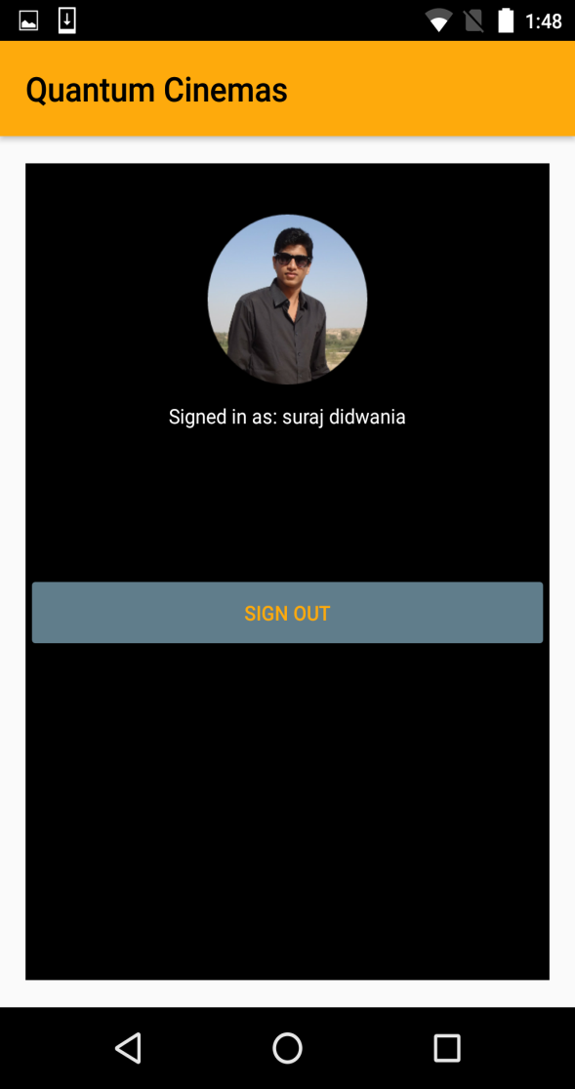
Google Login API:

Slide 15
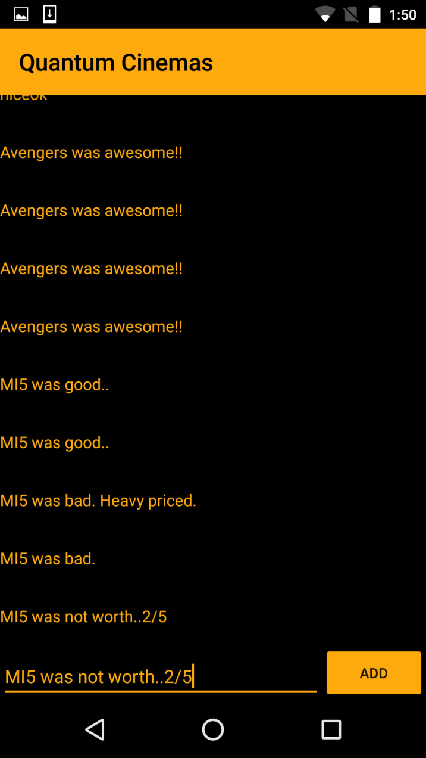
Movie Reviews/Live Chat :

Slide 16
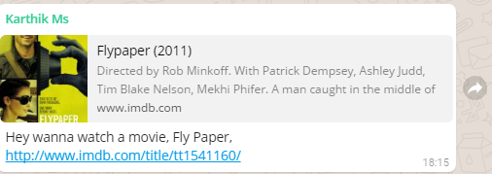
Share Movie Details:

Slide 17
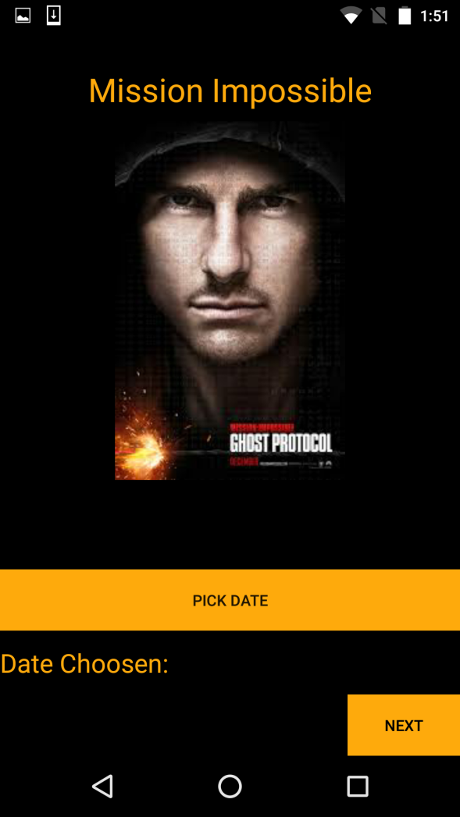
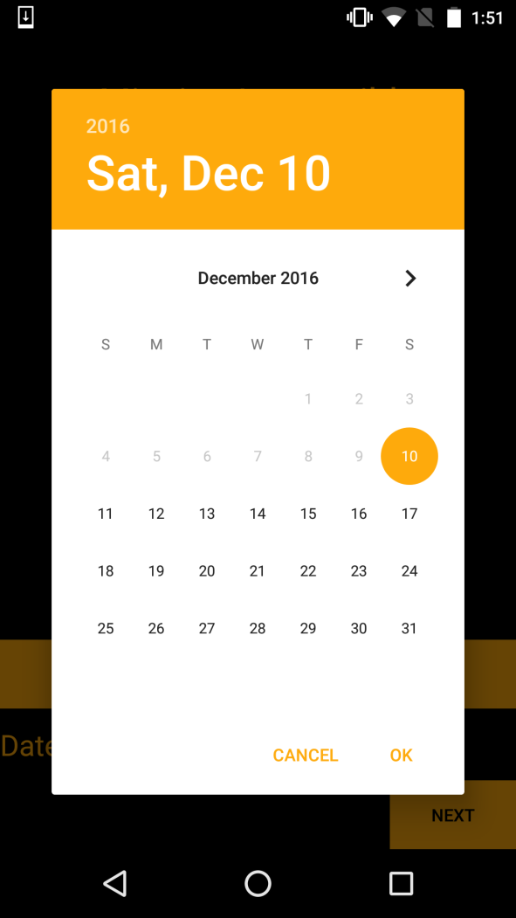

Pick up Date from Calendar:

Slide 18
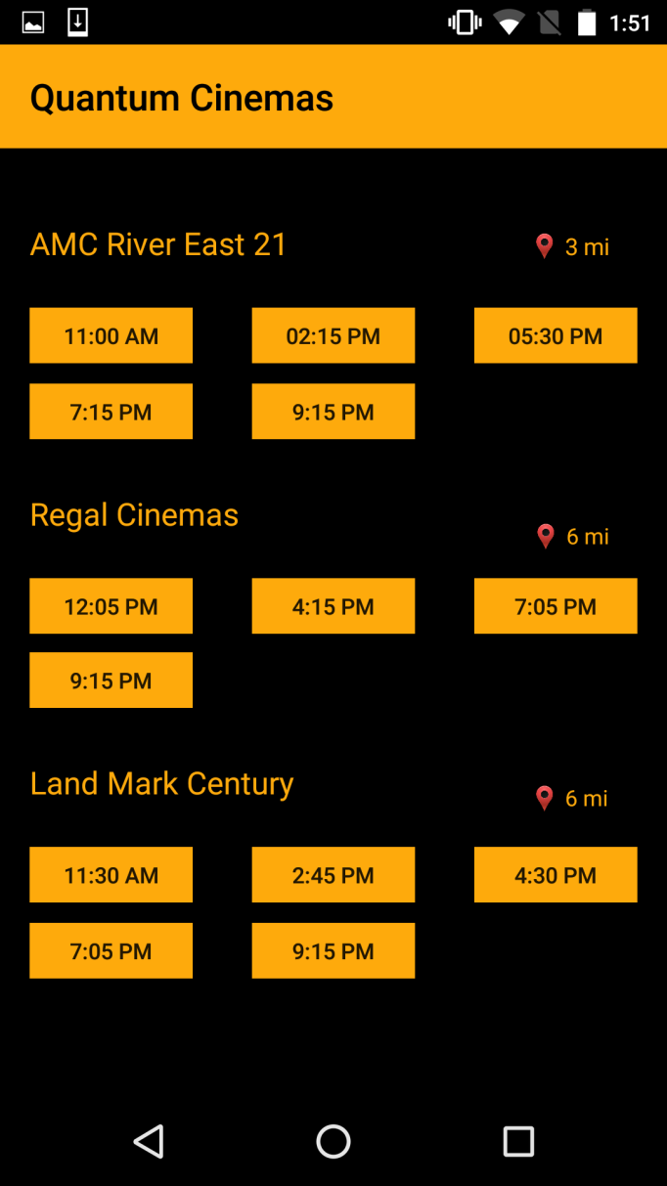
Theatres and Timings As Per Location:

Slide 19
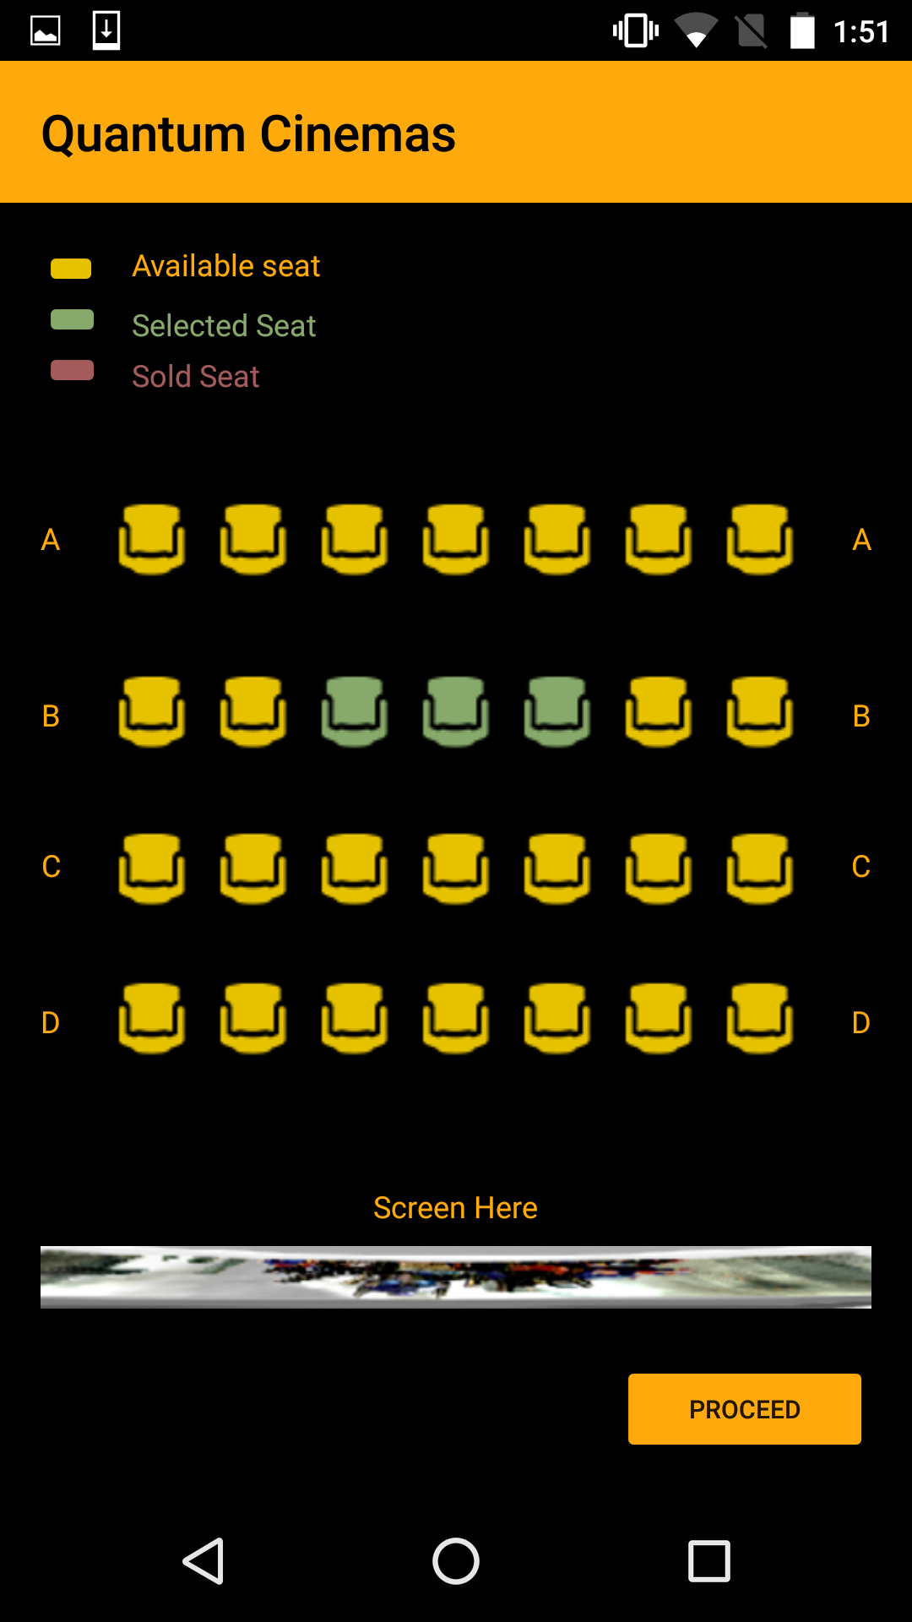
Multiplex GUI Seat Selection:

Slide 20
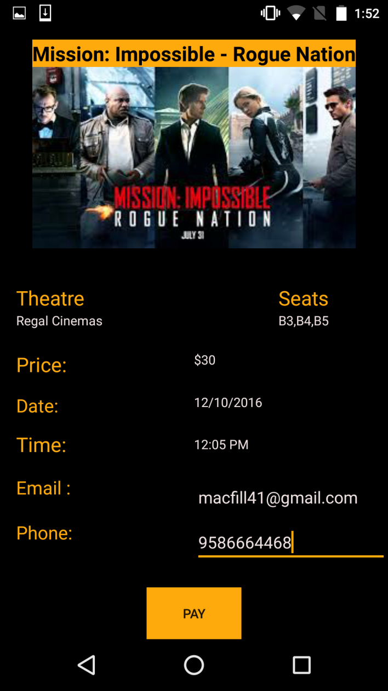
Information Confirmation:

Slide 21
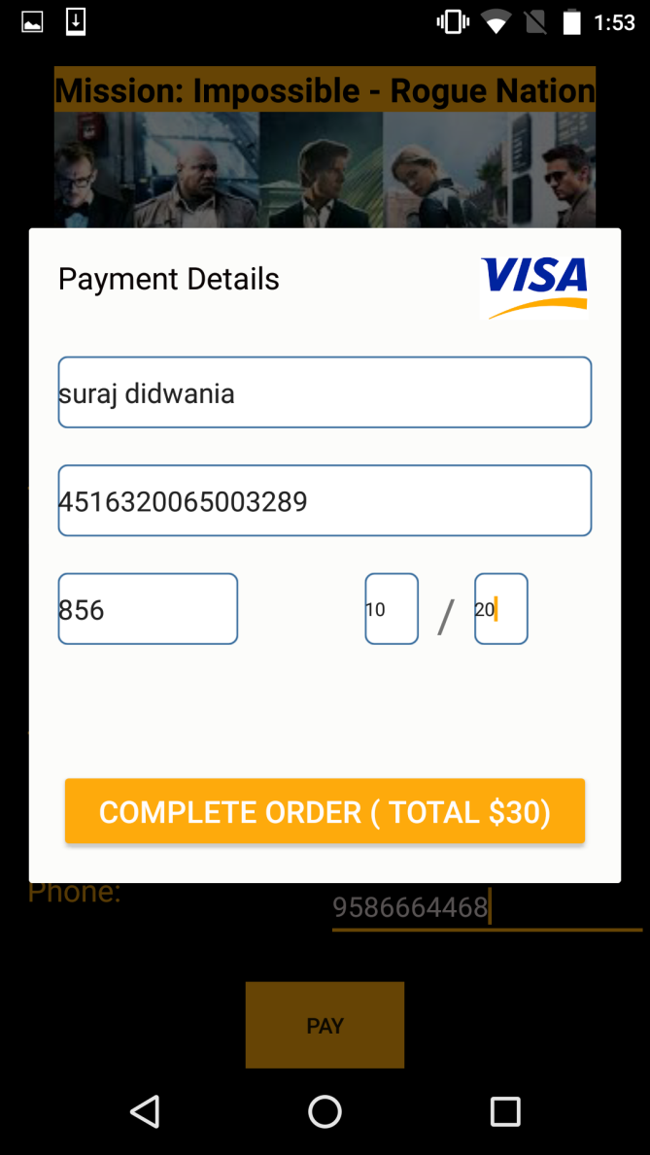
Payment Details with Total Amount:

Slide 22
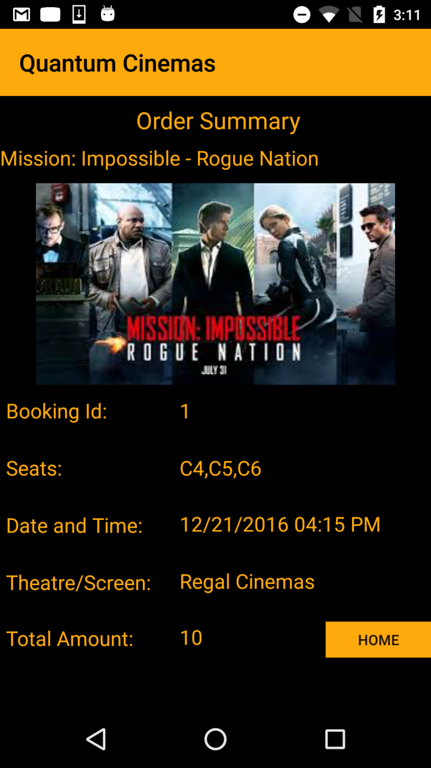
Movie Confirmation Screen:

Slide 23
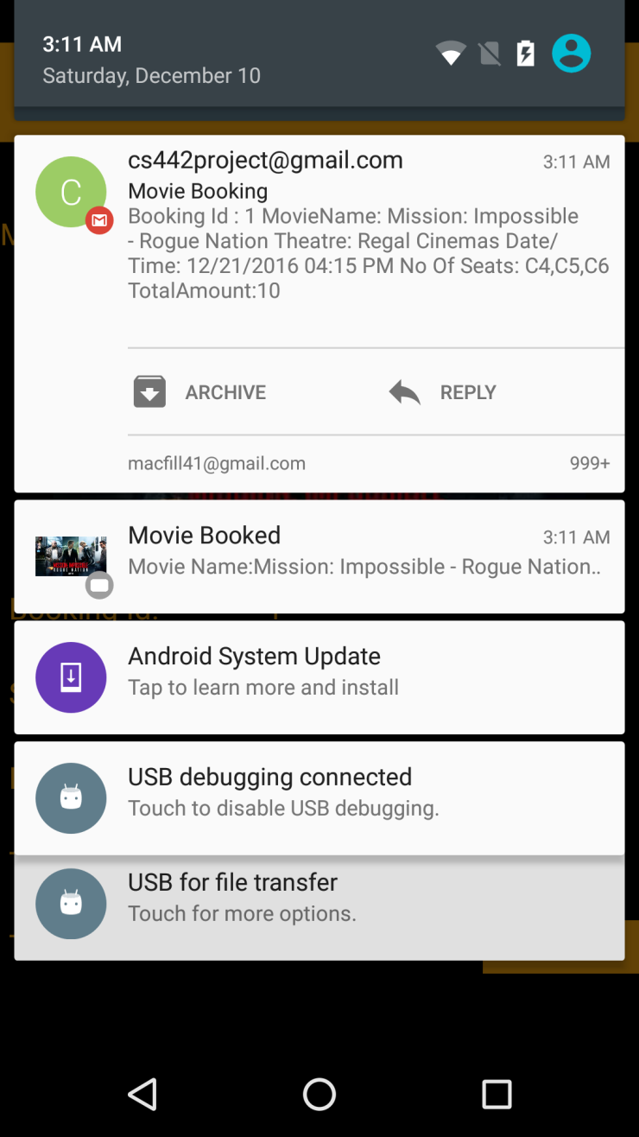
Email and Text-To-Speech Notification:

Slide 24
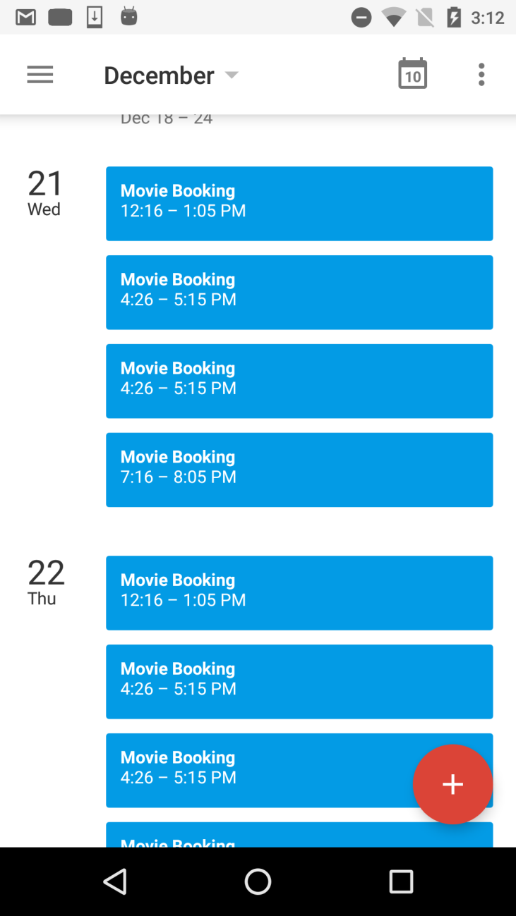
Reminder in Calendar:

Slide 25
Future Enhancement:
Adding Google maps for theatre location
Adding Tablet Landscape Mode for application
Adding Browse by Theatre in Navigation
Loading more videos in gallery and movies dynamically from database
Launching application to Google play services and making app available to very android devices.
Displaying History of orders to signed in users.

Slide 26
Conclusion:
We have come up with such an interesting and useful application that helps users by all means.
This app successfully displays the movies list and theatres with GUI seat selection. The movie gets booked and confirmed.
It’s User interface is quite interactive that will attract the users to use it in more helpful manner.

Slide 27

Thank you! Questions?

